Slide 1
Span of Control
Sarthak Educational Trust

Slide 2
Coming together is a beginning, staying together is progress and working together is success.
-- Henry Ford

Slide 3
Why we work as a team?
Together
Everyone
Achieves
More

Slide 4
What constitutes our team?
Team Sarthak
Governing Body
Skill Development Centres
Early Intervention centre
Head Office Team
Guru and Mentor
Advisory Board
Board of Trustees

Slide 5
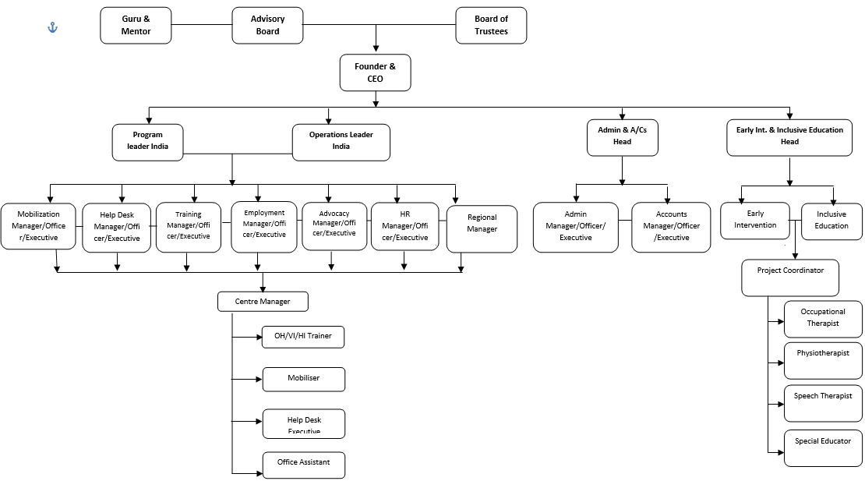
SARTHAK TEAM

